Slide 1
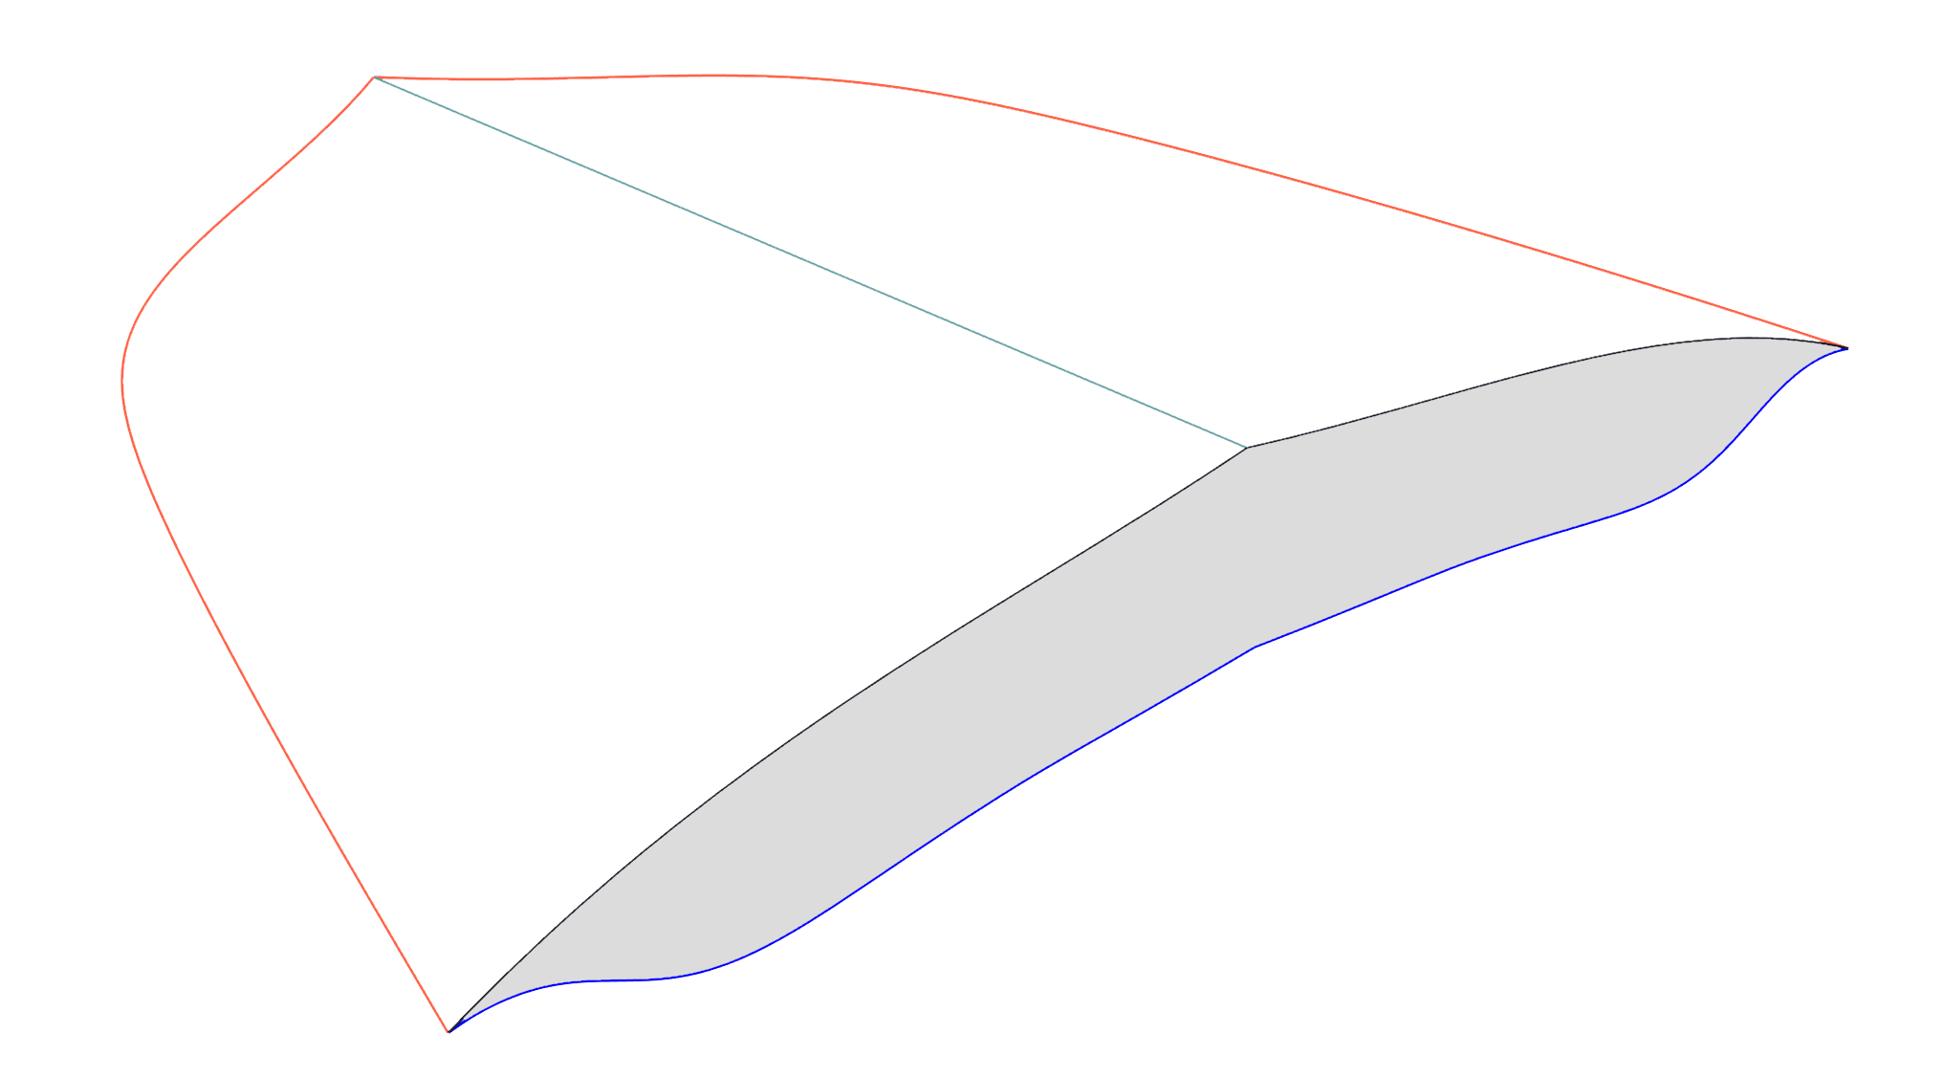
Leading Edge Curve
(LUC)
y
Symmetry Plane
O
z
x
Upper Surface Curve
(USC)
l
β
A
Lower Surface Curve
(LSC)
h
Shockwave Curve
(SC)
Base Plane

